Slide 1
QA/QC
Quality Assurance / Quality Control

Slide 2
The Annual Cost of ‘Bad Data’
to US Businesses
$14.2 million - $3.1 trillion
Gartner Research
IBM

Slide 3

(1) Cost of Lost Sales, etc.

Slide 4

(2) Cost of data cleanup

Slide 5
$1 to check the data at first point of entry, it likely costs $10 to correct the error as part of the greater batch. If the incorrect data slips through without correction, the cost of fixing the mistake by the time it reaches customers or the production line is likely to increase ten fold
1-10-100 Rule
“the cost of quality”
Data entry errors multiply costs exponentially according to the stage at which they are identified and corrected.
$1:
Price to check the data at first point of entry
$10:
Price to find and correct error when it is part of a batch
$100:
Cost of fixing the mistake when it reaches customers
prevention is less costly than correction is less costly than failure

Slide 6
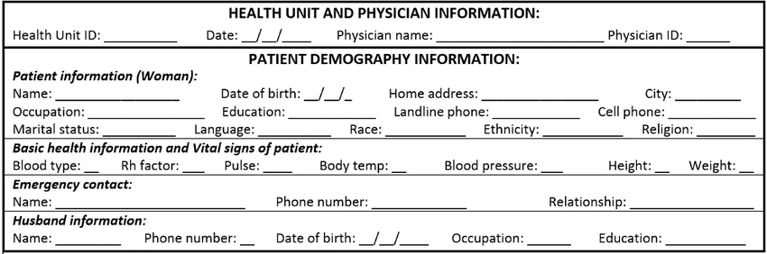
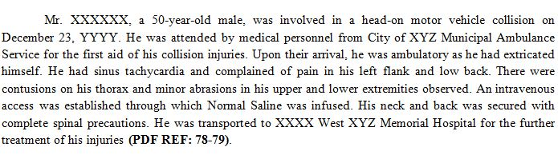
Goldberg et al. (2008):
error rates in two clinical research databases
Demographic data:
2.3-5.2%
Treatment data:
10-26.9%
Includes errors made during data entry and misinterpretation of data contained on the original forms.
Goldberg, S. I., Niemierko, A., & Turchin, A. (2008). Analysis of data errors in clinical research databases. AMIA Annual Symposium proceedings. AMIA Symposium, 2008, 242–246.

Slide 7
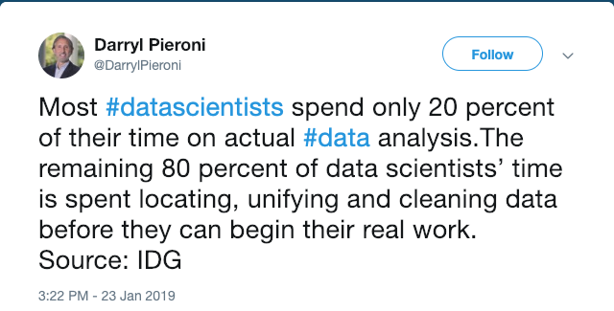
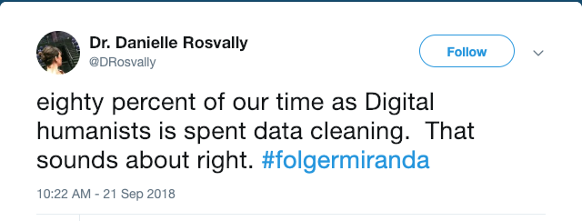
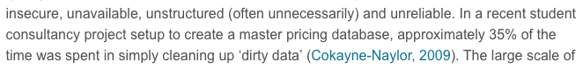
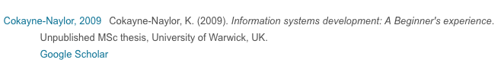

Slide 8





data
acquisition
data
processing
data
analysis
data
presentation
QA
QC
Proactive or preventive process to avoid problems
Process to identify and flag suspect data after they have been generated.
Put another way….
Notes:
The concepts of QA and QC are often used together and are closely related, but each has a distinct meaning. The major difference is that QA is process oriented, whereas QC is product oriented.

Slide 9
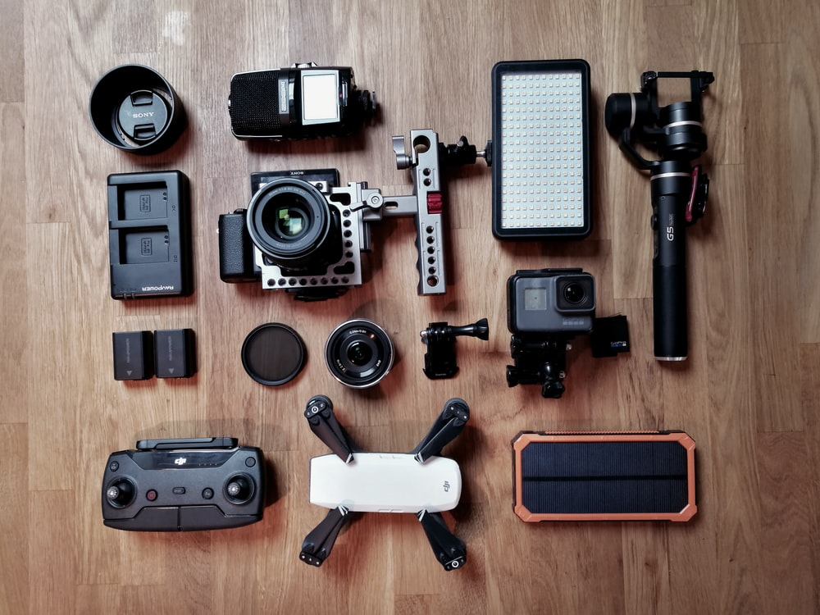
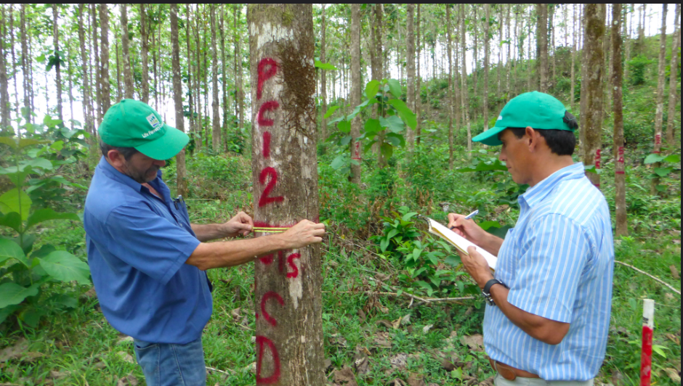




Before Data Collection
During Data Collection
data
acquisition
During Data Entry
After Data Entry
QA
data
processing
QC

Slide 10
Before Data Collection
Notes:
Quality Assurance is all about minimizing those mistakes – preventing them from entering the dataset in the first place. Strategies for preventing errors from entering a dataset will be the focus of the next two weeks (and another session later on in the semester).
Before data collection: this is things like checking equipment to make sure it’s working, that it is properly calibrated so that measurments are accurate, having extra batteries, using checklists to make sure you have all the equipment you need to collect data accurately – be it notebook and pencil, or a recorder, a video camera, or whatever. It also means a clear plan for recording and backing up field data (remember that? We already discussed it). If you’re collecting data using instruments, be sure oyu have standards for calibration. Same with balances, thermometers, etc.

Slide 11
During Data Collection
Notes:
We’ll talk about Quality Assurance DURING data collection in a few weeks so let’s leave that aside for now. It’s actually one of my favorite topics, so be prepared…

Slide 12
QA/QC
Quality Assurance / Quality Control

Slide 13
During Data Entry
Notes:
Data entry is where a MOST mistakes get into your data files. It is repetitive, boring, and we often rush through it to get to the fun part…data analysis! And this is exactly why mistakes get in there.

Slide 14

Notes:
Three things going here are problematic: the music in the headphones, the soccer game in the TV on the TV on the wall, and how this person is entering data.

Slide 15

Notes:
Like, you he’s probably entering data iusing one of these keyboards with numeic keypad…and we’ve used these so much we;’ve memorized the position of the keys and can fly through the typing.

Slide 16
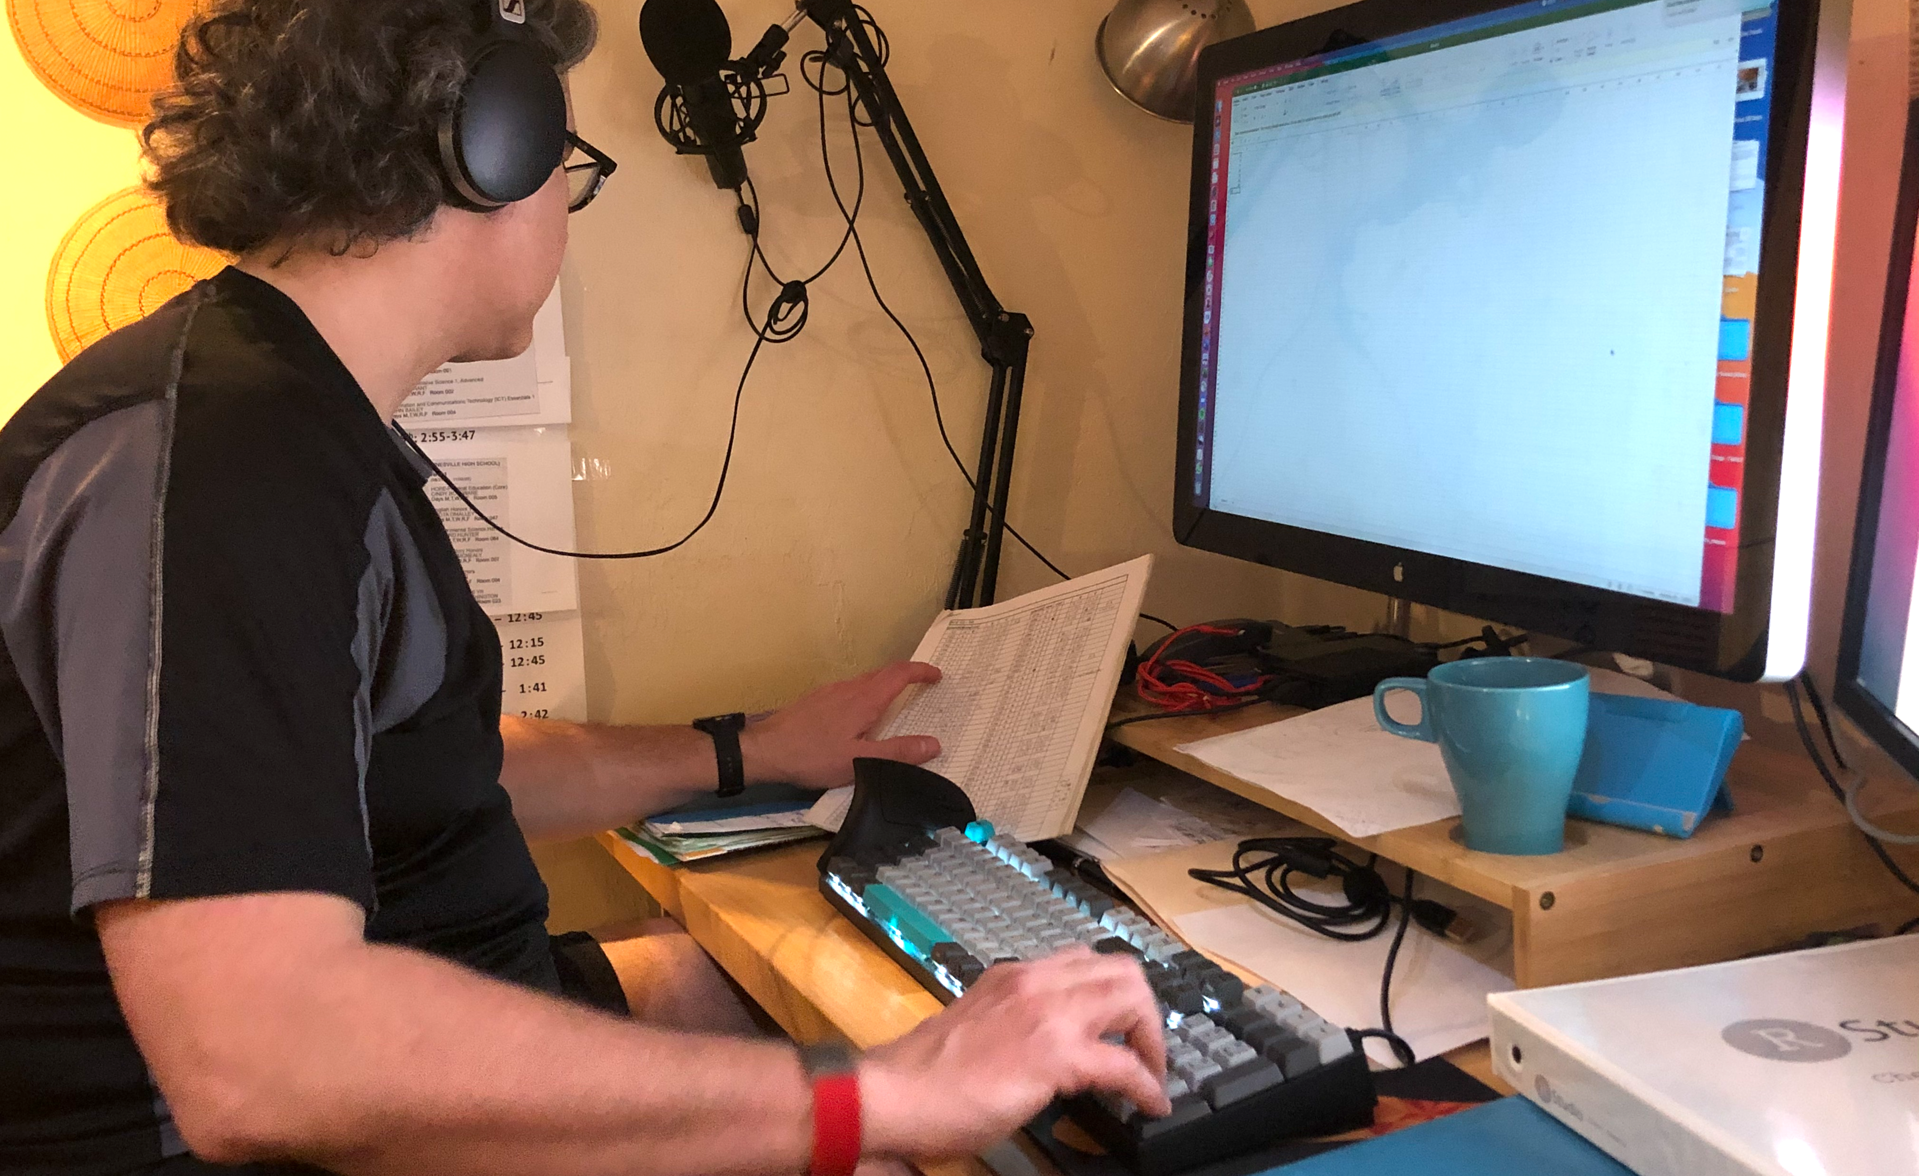
Notes:
THAT IS HOW MISTAKES GET IN _ WE’RE LOOKING AT THE DATA SHEET< AND NOT THE MONITOR OR OUR HANDS.

Slide 17

?
=
Notes:
The gold standard is what is called “Double Data Entry”: two people enter data independently and then you compare.

Slide 18

Notes:
Now you might be temnpted to think that if you look it over after entry you’ll catch mistakes.

Slide 19

Notes:
Or maybe even enter it with someone else watching over your shoulder or reading rhe data to you and veriftying your entry.

Slide 20
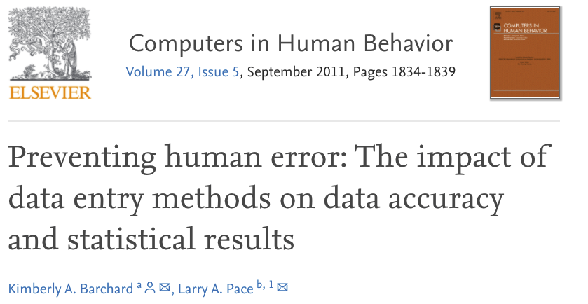
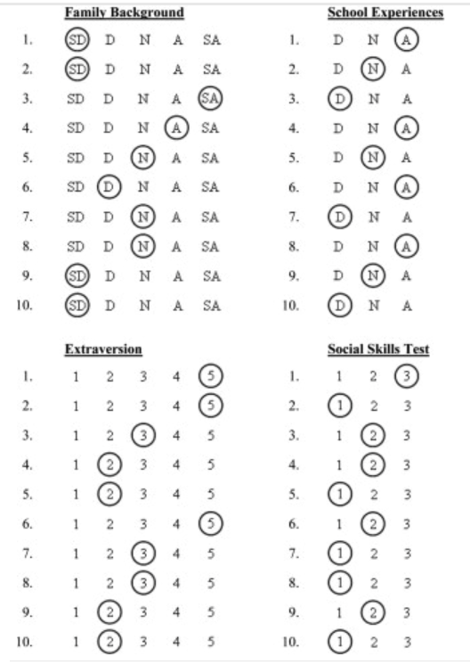
Methods
195 undergraduates
3 data entry methods (double entry, visual checking, single entry).
Each entered 30 data sheets, each w/ 6 types of data.
Results
Visual checking: 2958% more errors than double entry
Visual entry = not significantly better than single entry.
Perfect accuracy:
Double entry: 77.4% of participants
Visual checking: 17.1%
Single entry: 5.5%
Notes:
coefficient alpha, which was sometimes wrong by more than .40. Moreover, these data entry errors would be hard to detect: Only 0.06% of the errors were blank or outside of the allowable range for the variables. Thus, researchers cannot rely upon histograms and frequency tables to detect data entry errors.

Slide 21
?
=
Notes:
Today we’re going to work on the things that will increase the accuracy of each individual’s data entry, which will in turn simplify the comparison and data validation.
We’ve actually done one already:

Slide 22
During Data Entry

Slide 23
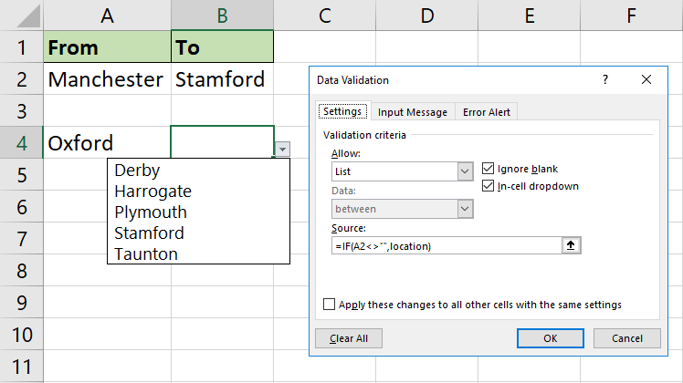
Data Validation

Slide 24
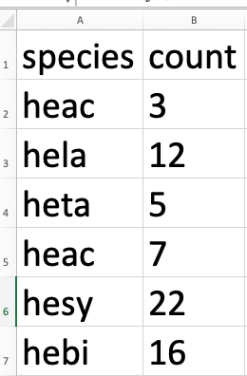
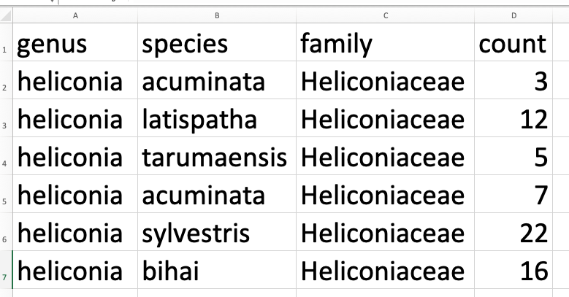
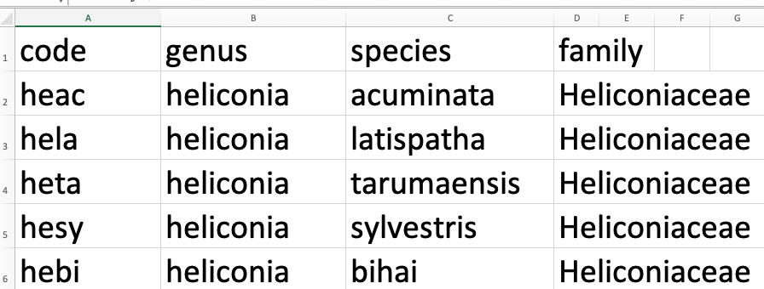
Atomized Data Entry
(one data type per cell)
Simplify Entry using Codes,
Eliminate duplication

Slide 25


Single-user tool #1
Text

Slide 26
How does it work?

Slide 27

Single-user tool #2
Record a reading of the data and then transcribe from the recording

Slide 28
QA/QC
Quality Assurance / Quality Control

Slide 29
After Data Entry

Slide 30
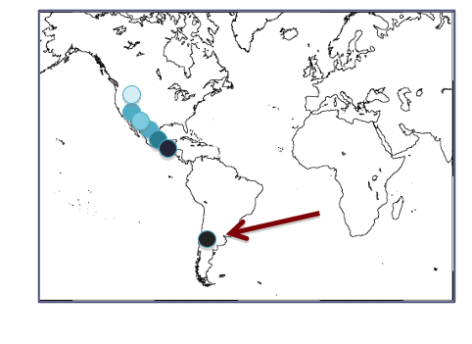
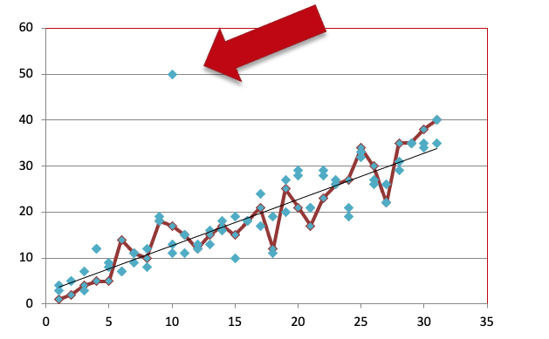
1) Visualize the Data
Great way to look for outliers
(i) Normal probability plots (ii) Regression (iii) Scatter plots (iv) maps
(v) Subtract values from mean (vi) change from last year’s measurement (vii) statistical tests for outliers
Notes:
Look for outliers: Outliers are extreme values for a variable given the statistical model being used
They could be a problem with the equipment used
They could be a problem with data entry
Outliers could be real values
Statistical determination:
Outliers may be detected by using Dixon’s test, Grubbs test or the Tietjen-Moore test.

Slide 31
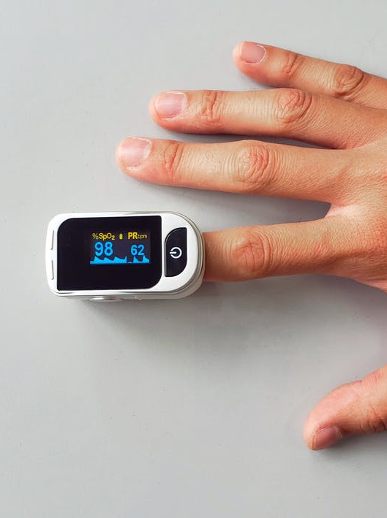
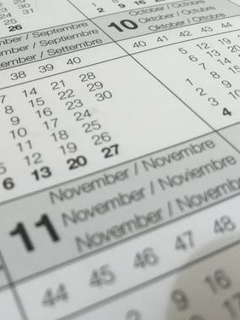
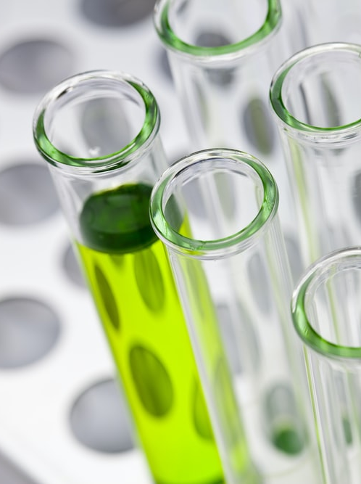
2) Summarize the Data
Do the values look reasonable?
Notes:
Data collected by instruments:
Values recorded by instruments should be checked to ensure they are within the sensible range of the instrument and the property being measured. Example: Concentrations cannot be < 0, and wind speed cannot exceed the maximum speed that the anemometer can record.
Analytical results:
Values measured in the laboratory should be checked to ensure that they are within the detection limit of the analytical method and are valid for what is being measured. If values are below the detection limit, they should be properly coded and qualified.
Any ancillary data used to assess data quality should be described and stored. Example: data used to compare instrument readings against known standards.
Observations (such as bird counts or plant cover):
Range checks and comparisons with historic maxima will help identify anomalous values that require further investigation.
Comparing current and past measurements help identify highly unlikely events. For example, it is unlikely that the girth of a tree will decrease from one year to the next.
Dates and times:
Ensure that dates and times are valid
Time zones should be clearly indicated (UTC or local)
Data Types:
Values should be consistent with the data type (integer, character, datetime) of the column in which they are entered. Example: 12-20-2000A should not be entered in a column of dates).
Use consistent data types in your data files. A database, for instance, will prevent entry of a string into a column identified as having integer data.
Geographic coordinates:
Map coordinates to detect errors

Slide 32

3) Annotate the Data
Mark data with quality control flags
Verified
Needs review
Needs correction
Data interpolated

Slide 33
96%
99%
Notes:
Here’s the thing – you wont make too many

